Slide 1
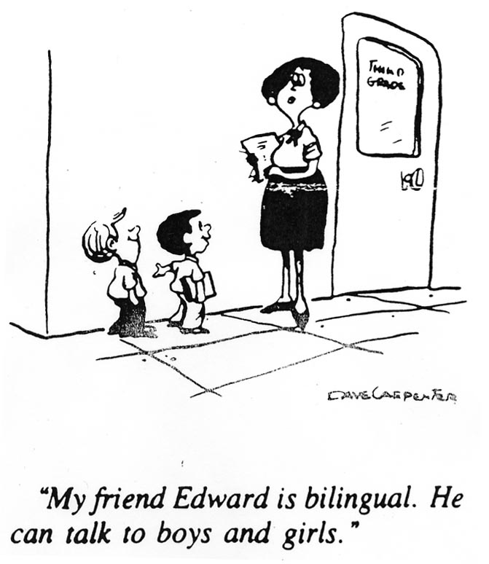
The SIOP Model
Teaching English Learners

Slide 2
Today’s Objective
TWBAT identify the 8 key components of SIOP.
TWBAT name teaching/learning strategies that can be incorporated into lessons to support language development.

Slide 3
Please Read:
The goal of ESOL is to develop the language acquisition skills of ELs. CO and LO must be posted during a lesson. During instruction, ELs use L1 and L2 to understand instruction. Realia must be used consistently for language development. Knowing the difference between BICS and CALP is essential for determining the ELs level of understanding and proficiency. Please always use HOTS in lesson planning for SI to be effective.

Slide 4
Acronym Vocabulary
S I O P=Sheltered Instructional Observation Protocol
ELs=English Learners
L1=Native Language/First Language
L2=English/Second Language
Realia=Real Life Objects
CO=Content Objectives
LO=Language Objectives
BICS=Basic Interpersonal Communicative Skills
CALP=Cognitive/Academic Language Proficiency
SI=Sheltered Instruction
HOTS=Higher Order Thinking Skills

Slide 5
The Affective Filter Hypothesis
When faced with an unfamiliar situation, people put up a shield to protect themselves.
The BEST language acquisition will occur in environments where the affective filter is low.
Students must feel comfortable in class in order to learn.
Team Builder exercises should be used to lower everyone’s shields.

Slide 6
Team Builders
Should be done frequently during the first few days of class to lower students’ shields.
Should be done every time you make group/table changes.
A class builder should be done at least once a month.
Should be fun and low stress for students.

Slide 7
What is the SIOP Model?
Sheltered instruction (SIOP) is an approach for teaching content to English learners (ELs) in strategic ways that make the subject matter concepts comprehensible while promoting the students’ English language development.
(Echevarria, Vogt, and Short-Making Content Comprehensible for English Learners, page 2)
Teaching Model, not a new program
Differentiated Learning, but Cognitively Challenging

Slide 8
The Eight Steps of a SIOP Lesson
1. Preparation
2. Building Background
3. Comprehensible Input
4. Strategies
5. Interaction
6. Practice/Application
7. Lesson Delivery
8. Review/Assessment

Slide 9
Key Concepts for Preparation
Most IMPORTANT part of a SIOP Lesson!
Post written content and language objectives for each lesson.
Have students read objectives at the beginning of each lesson (chorally, echo, choral cloze).
Write objectives in kid friendly language.
“I can…” “I will…” “SWBAT…”
Discuss any words in objectives that are new.

Slide 10
Ideas for Preparation
Create Outlines for notes, so that students can just fill in the blanks while trying to follow along.
Highlighted Text- highlight important vocabulary and ideas in the text before you teach that unit.
Marginal notes- As well as highlighting text, you could also place simplified definitions or notes in the margins. If you can’t write in the textbooks, use post-its.
Taped/Adapted text
Watching the films before the unit or book.

Slide 11
Building Background Ideas
Try to link concepts to students’ background experience.
Content Word Walls in classrooms
Concept/Vocabulary Definition Map
Visual Vocabulary with pictures
Use Realia-real life objects
KWL, Brainstorming, Word Splash, Quick Writes
Strategies: “Stand up if …” , “Just like Me”, “Have you ever…”

Slide 12
Comprehensible Input Ideas
Use appropriate speech and pacing
Avoid idioms
Slow Down!
Think Time
Model Expectations or Activities
Use Visual and Oral Instructions
List Instructions, Number steps, Keep it Simple
Check for understanding
0, 1, 2, 3 Fingers
Pencils Up/Down or Thumbs Up/Down

Slide 13
Learning Strategies
What the students use to learn
Must teach strategies and model the process
Provide practice using the strategy
Examples:
Highlighting Key Concepts/Vocabulary
Taking Notes-Post-It Notes, Note Cards
Mnemonic Devices
Sorting Information
Each One Teach One
Study groups-Jigsaw, Think-Write-Pair-Share,

Slide 14
Tool Box of Strategies
When teaching learning strategies, answer:
What is the tool?
How do I use it?
When and why do I use it?
The 1st time a student uses a new strategy, use familiar material-not something new.

Slide 15
Scaffolding
Verbal-Think Alouds, Paraphrasing, Correct Speech and Usage
Procedural-Explicit Teaching/Modeling
Instructional-Graphic Organizers
4 Quadrant Activity
Frayers
Vocabulary Maps, Boxes,
Foldables

Slide 16
Instructional Techniques
Preview & Predict
Textbook Tour
GIST-10 Key words to summarize
Graffiti Write
Chunk and Chew (5-2-1 Rule)
Stretch It!
Musical Share
All Hands Up-(Phone a Friend or 50/50)
Check My Work
Stand-Up, Hand-Up, Pair-Up
Sentence Frames/Language Frames

Slide 17
Table/Group Interaction
Have jobs for each member of the table/group
Rotate the jobs each day or week
Provide many opportunities for interaction and discussion.
Use a variety of grouping configurations.
Shoulder/Elbow Partners, Eyeball/Face Partners, Triads
Numbered Heads and Randomizers

Slide 18
Activities for Peer Interaction
Think-Write-Pair-Share
Turn and Talk
Roundtable
Jigsaw
Rally Robin (partners), Round Robin (group)
Find Someone who…
Inside/Outside Circle
Pair-Share-Trade
Reader’s Theater
Conversation Cubes

Slide 19
Ideas for Practice and Application
Lots of hands-on materials
Integrate reading, writing, speaking, and listening into each lesson.
Small groups and partners
Videos-Write down key points, answer questions, cloze activities. Pair-Share
Use Closed Captioning
Stand up, Hand up, Pair up
Can You Guess? Cloze Activity
Four corners
Jigsaw
Stand up/Sit down

Slide 20
Lesson Delivery
Clearly support content and language objectives.
Engage students (90-100%)
Reduce teacher talk
Pace rate that you give information according to levels in your classroom
Use Instructional Techniques
Give enough time to accomplish tasks
Notes:
All students should be actively involved in learning.
Teachers talk 70% of one hour, students 30%.
Students need 5-8 seconds to process a question or new information. Give appropriate wait time!

Slide 21
Review and Assessment
Review Content and Language Objectives
Review key vocabulary/key concepts
Use a variety of quick reviews throughout the lesson such as the following:
Self Check-0, 1, 2, 3 Fingers
Agree/Disagree
Pencils up/down, Thumbs up/down, Stand up/Sit down
Interactive Response Cards
Response boards-white boards
Activ Votes, Poll Everywhere
*Tickets out the door-Tweets, 3-2-1, Outcome Sentences, Aha! Moments

