Slide 1
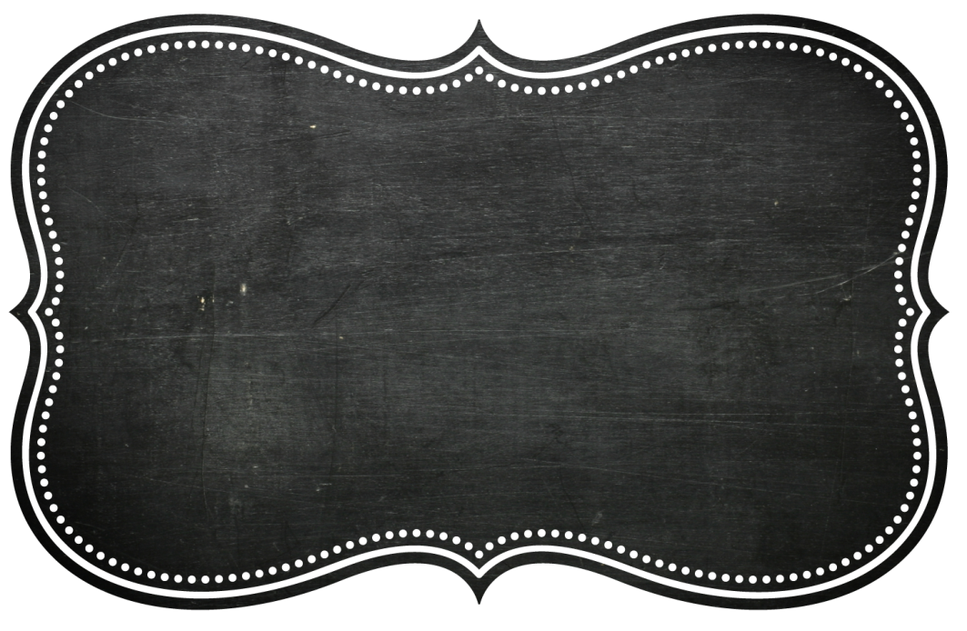
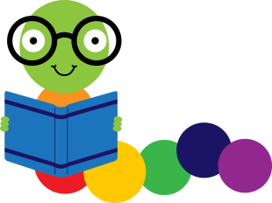
Copyright and Fair Use
Media Specialist’s Times
Jennifer Martin
Boston Elementary
What Is Copyright?
What is protected by copyright?
Literary works
Music and lyrics
Dramatic works and music
Pantomimes and choreographic works
Photographs, graphics, paintings and sculptural works
Motion pictures and other audiovisual works
Video games and computer software
Audio recordings
Architectural works
Copyright is a form of legal protection automatically provided to the authors of “original works of authorship,” including literary, dramatic, musical, and artistic works. U.S. copyright law generally gives the author/creator or owner of an original creative work an exclusive right to:
Reproduce (copy) or distribute the original work to the public (e.g., create and sell copies of a film)
Create new works based upon the original work (e.g., make a movie based on a book)
Perform or display the work publicly (e.g., perform a play)
Violation of one of these rights is called copyright infringement. However, the use may be authorized by copyright limitations (such as fair use). Taken verbatim from “Teaching Copyright”
“Copyright was established to encourage the growth of science, education, and the arts.” (CMSI)
What is Fair Use?
Fair use is the right to use copyrighted material without permission or payment under some circumstances—especially when the cultural or social benefits of the use are predominant. It is a general right that applies even in situations where the law provides no specific authorization for the use in question—as it does for certain narrowly defined classroom activities. Taken verbatim from “Teaching Copyright”
Fair use does not apply to Creative Commons or Public Domain materials because those materials are free to use with appropriate attribution.
United States Copyright Law
1787
Copyright written into the United States Constitution in Article 1, Section 8, “Congress shall have power…to promote the progress of science and useful arts, by securing for limited times to authors and inventors the exclusive right to their respective writings and discoveries.”
“Educators need to be leaders, not followers, in establishing best practices in fair use.” (CMSI)

Slide 2


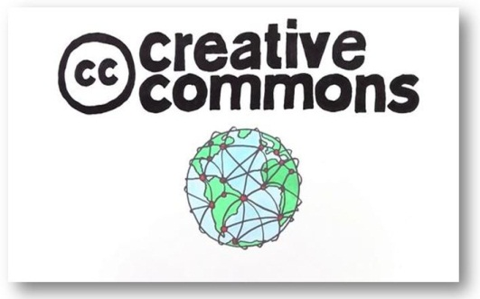
Fair Use Myths Busted
If in Doubt…
Fair use is too hard to understand so I should not use copyrighted material.
Fact-”Fair use is a part of the law that belongs to everyone—especially to working educators.”
Fair use sets limits on how much material can be copied from copyrighted material such as text, music, quotes and pictures.
Fact- Fair use does not have a “rule of thumb’ to go by. Each case should be considered individually for its educational benefit in relation to the amount of material used.
Using copyrighted material is absolutely forbidden.
Fact-Fair use helps to generate creativity and new ideas. It actually supports the 1st Amendment’s Freedom of Speech Right.
I could get sued for citing fair use of copyrighted materials.
Fact-If you use good reason when using the materials and can show the educational purpose, you most likely will be within the law.
As long as I am not making money off of the copyrighted materials, I can claim fair use and not get in trouble.
Fact- You must use good reason and be able to show educational purpose to be within the law.
I must contact the person for permission to use his material or fill out forms for permission.
Fact-No, you do not.
If I properly give attribution to my source of materials, I will not infringe on copyright laws.
Fact-Copyright is not like plagiarism. Just because credit is given to a source does not mean that copyright has been honored even through fair use.
Consider how your are using the copyrighted material.
How big is the audience that will view it?
Are you putting it on your website or blog where anyone can download the material and make copies?
Are you using it for commercial, non commercial or personal use?
Did you use more of the material than you really needed to convey the educational value?
Did you use the material exactly as found or did you transform it into something else?
Is it factual material or creative material?
Are you acting in good faith using good reason and best practices?
Will you benefit monetarily from the use of the material?
Will your use of the material affect the creator’s market or intended use?
Remember:
The courts treat each case of copyright infringement individually based on its policies of fair use. If you are acting in good faith and as an educational steward conveying knowledge to your students, your use of copyrighted materials will probably be considered fair use.
Websites and Resources for Educators
Teaching Copyright.org
Copyright.gov
Creative Commons.org
Copyright Guidelines for Educators
The Edublogger.com

Slide 3
References
Copyright and Fair Use Guidelines for Teachers. (2014). Retrieved from Tech Learning.com: http://www.techlearning.com/techlearning/pdf/events/techforum/tx05/t eachercopyright_chart.pdf
Fair Use. (2014). Retrieved from Copyright.gov: http://www.copyright.gov/fls/fl102.html
Teaching Copyright. (2014). Retrieved from Teaching Copyright.org: http://www.teachingcopyright.org/
The Code of Best Practices in Fair Use for Media Literacy Education. (2014). Retrieved from Center of Media and Social Impact: http://www.cmsimpact.org/fair- use/related-materials/codes/code-best-practices-fair-use-media-literacy- education
Burt, R. (2012, February 9). The Educator’s Guide to Copyright, Fair Use, and Creative Commons. Retrieved from The Edublogger.com: http://theedublogger.com/2012/02/09/the-educators-guide-to-copyright- fair-use-and-creative-commons/

